Slide 1
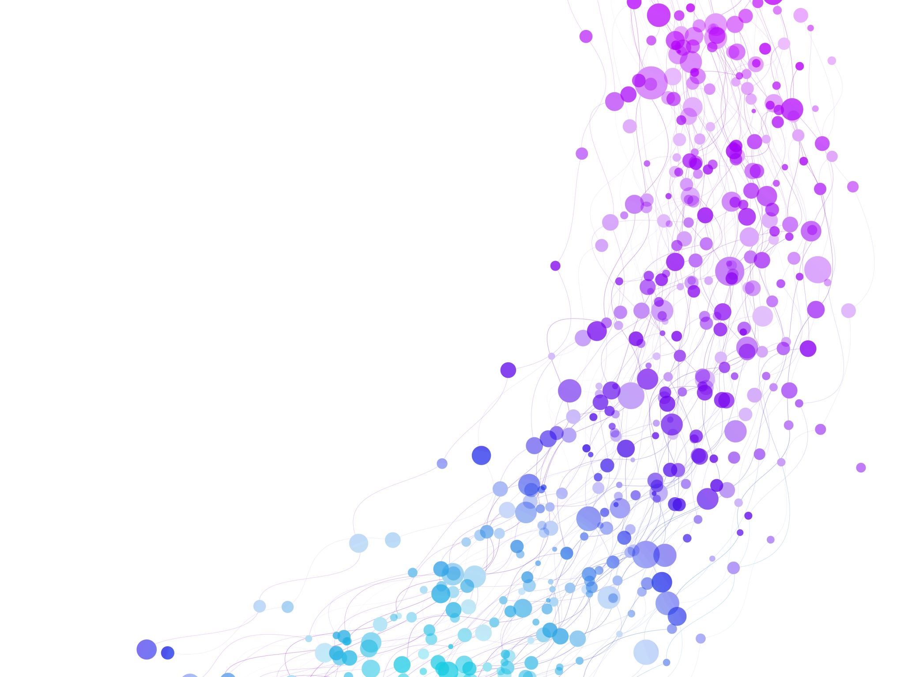


Efficient Algorithm, Complexity & Asymptotic Notation Session No.: 2 Course Name: Data Strucutres Course Code: R1UC308B Instructor Name: Dr. Gaurav Agarwal Duration: 50 mins Date of Conduction of Class: 21 Aug 2025

Slide 2

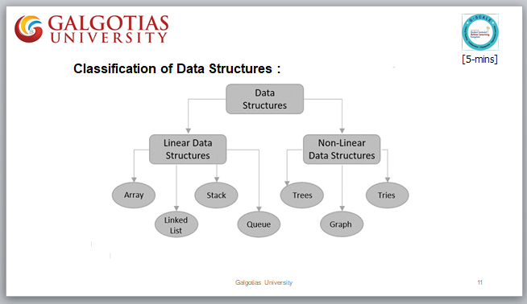
Review

Slide 3
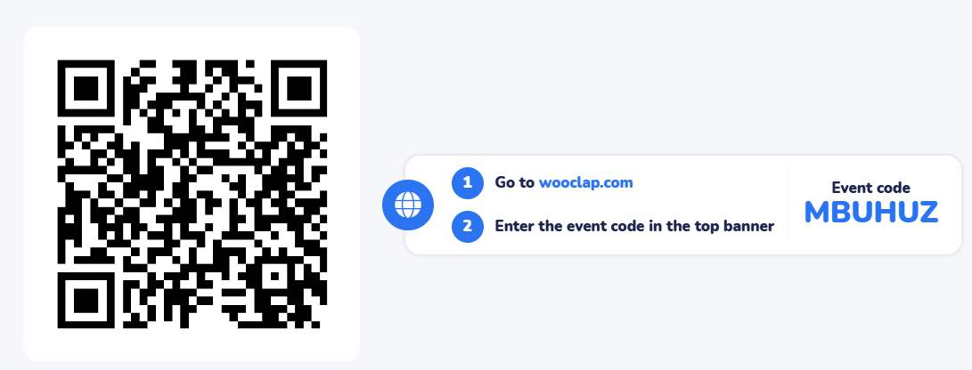
Pre-Class Assessment
[2-mins]

Slide 4

[1-mins]
What do you mean by efficient algorithm?

Slide 5
Learning Outcomes
[2-mins]
By the end of this session, You will be able to:
Explain the importance of analyzing algorithm efficiency in terms of time and space complexity.
Apply asymptotic notations (Big-O, Big-Ω, Big-Θ) to evaluate the performance of algorithms.

Slide 6
Session Outline
Efficient algorithm
Time & Space Trade-off
Complexity & Asymptotic Notation
Provide hands-on activities and reinforce learning through an interactive WooClap and WooFlash tools.

Slide 7

Activity-1 (Think – Pair – Share)
[1-mins]
If two algorithms solve the same problem, how can we decide which one is “better”?
Trade-off between
Time & Space

Slide 8
Efficiency of an algorithm :
▶ To go from city “A” to city “B”, there can be many ways of accomplishing this: by flight, by bus, by train and also by bicycle.
▶ Depending on the availability, convenience, and affordability etc., we choose the one that suits us.
▶ Similarly, in computer science, multiple algorithms are available for solving the same problem (for example, a sorting problem has many algorithms, like insertion sort, selection sort, quick sort and many more).
▶ Algorithm analysis helps us to determine which algorithm is most efficient in terms of time and space consumed.
▶ The goal of the analysis of algorithms is to compare algorithms (or solutions) mainly in terms of running time but also in terms of other factors e.g., memory, developer effort, etc.

Slide 9
Time-space trade-off
A tradeoff is a situation where one thing increases and another thing decreases. It is a way to solve a problem in:
▶ Either in less time and by using more space
▶ In very little space by spending a long amount of time.
The best Algorithm is that which helps to solve a problem that requires less space in memory and also takes less time to generate the output.
But in general, it is not always possible to achieve both of these conditions at the same time.
The most common condition is an algorithm using a lookup table.
This means that the answers to some questions for every possible value can be written down.

Slide 10
One way of solving this problem is to write down the entire lookup table, which will let you find answers very quickly but will use a lot of space.
Another way is to calculate the answers without writing down anything, which uses very little space, but might take a long time.
Therefore, the more time-efficient algorithms you have, that would be less space-efficient and vice-versa and you have to decide by the help of trade-off between time and space.

Slide 11
Complexity Analysis
When we design an algorithm, we want to know how much time and space it will take to run for an input of size n. This is called complexity analysis.
Time Complexity: Amount of time taken by an algorithm as a function of input size n.
Space Complexity: Amount of memory required by an algorithm as a function of input size n.
Example:
Linear Search: Worst case requires scanning all n elements → O(n) time.
Binary Search: Repeatedly halves the search space → O(log n) time.

Slide 12
Asymptotic Notations
Asymptotic notations describe the upper bound, lower bound, and tight bound of an algorithm’s running time.
Big-O (O) – Upper Bound
Represents the worst-case growth rate of an algorithm.
Example: Linear Search → O(n).
Big-Ω (Ω) – Lower Bound
Represents the best-case growth rate.
Example: Linear Search → Ω(1) (if the element is found at first position).
Big-Θ (Θ) – Tight Bound
Represents the average or exact bound (both upper and lower).
Example: Linear Search → Θ(n).

Slide 13
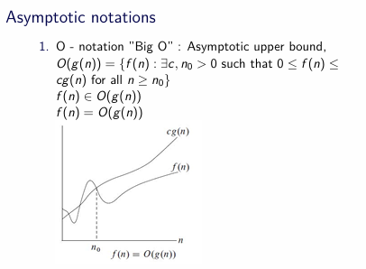
Asymptotic Notations
Asymptotic notations describe the upper bound, lower bound, and tight bound of an algorithm’s running time.
Big-O (O) – Upper Bound
Represents the worst-case growth rate of an algorithm. The worst-case running time of an algorithm gives us an upper bound on the running time for any input. So it guarantees that the algorithm will never slower than this.
In real applications, worst case normally occurs for example searching a non existing data.
Example: Linear Search → O(n).

Slide 14

Asymptotic Notations
Asymptotic notations describe the upper bound, lower bound, and tight bound of an algorithm’s running time.
Big-Ω (Ω) – Lower Bound
Represents the best-case growth rate.
Best case is like an ideal case which guarantees that the algorithm will never faster than stated. Based upon this we can’t allocate the resources.
Example: Linear Search → Ω(1) (if the element is found at first position).

Slide 15
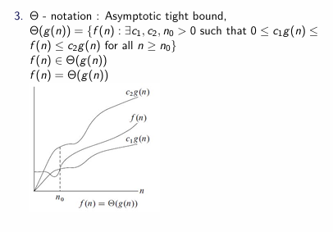
Asymptotic Notations
Asymptotic notations describe the upper bound, lower bound, and tight bound of an algorithm’s running time.
Big-Θ (Θ) – Tight Bound
Represents the average or exact bound (both upper and lower).
Average case normally perform as worst case because normally we take average case as average of best and worst or best for half size input and worst for other half size.
Example:
Linear Search → Θ(n/2)=. Θ(n)

Slide 16
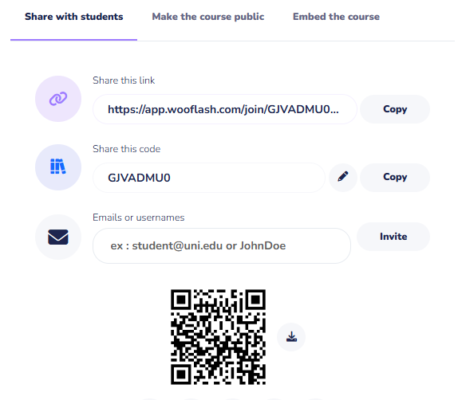
Assessment: WooFlash Quiz

Slide 17
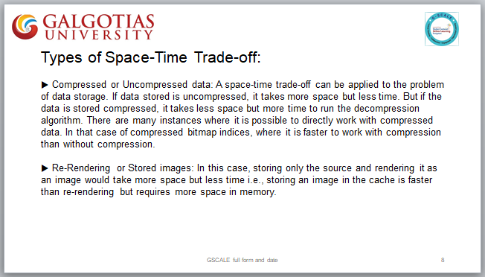
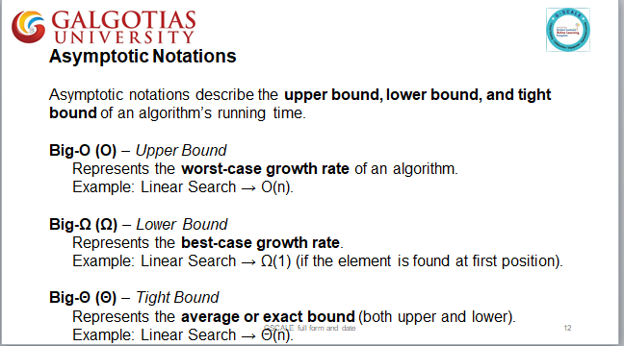
Summary
[1-mins]

Slide 18
[2-mins]
Ensure attainment of LO’s in alignment to the learning activities:
Explain the importance of analyzing algorithm efficiency in terms of time and space complexity.
Apply asymptotic notations (Big-O, Big-Ω, Big-Θ) to evaluate the performance of algorithms.

Slide 19
[1-min]
Next Session:
Calculate Time and Space Complexity

Slide 20
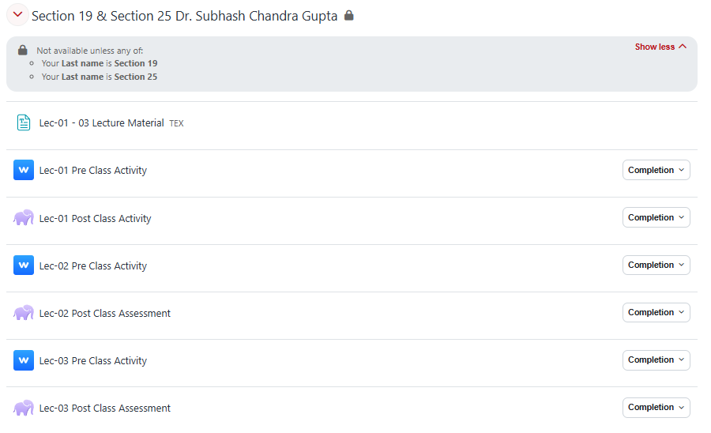
Review and Reflection from students

